Slide 1
ORACLE PL/SQL
PL/SQL Composite Data Types
LEVEL – LEARNER

Slide 2








Icon Used
Hands on Exercise
Reference
Questions
Points To Ponder
Coding Standards
Lend A Hand
Summary
Test Your Understanding

Slide 3

Overview
PL/SQL Composite data types session provides knowledge and understanding of the use of PL/SQL composite data types and collections in Oracle 10G and finally apply the syntax learned as part of this session in a case study provided.

Slide 4

Objective
To understand the PL/SQL composite data types that a developer needs to know to work with it.
PL SQL Composite Data Types
PL/SQL records
PL/SQL collections

Slide 5
Scenario
For complete understanding of ANSI SQL we are going to make use of Product Management System (PMS) for ABC Traders.
ABC Traders is a company which buys collectable model cars, trains, trucks, buses, trains and ships directly from manufacturers and sells them to distributors across the globe. In order to manage the stocking, supply and payment transactions the above software is developed.
As per the requirement of the trading company a inventory system is developed to collect the information of products and customers and their payment processing.

Slide 6
Database tables
There are many entities involved in Product Management System. PMS as given below which we will be dealing with throughout this course
Offices
To maintain information of Offices e.g. Office code, address, city etc.
Customer
To maintain customer details e.g. Customer Name, address
Employees
To maintain employee
details e.g. id,
Name etc.
Products
To maintain information of products e.g. product id, name etc.
Payments
To maintain information of payments done e.g. payment date, amount etc.
Orders
To maintain Orders done by customers e.g. order no ,date etc.
OrderDetails
To maintain Orders done by customers e.g. order no ,date etc.

Slide 7
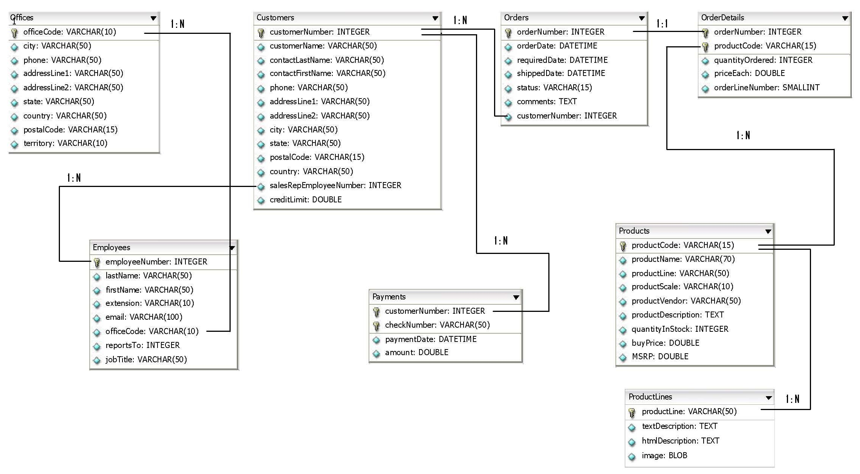
Schema diagram
Notes:
Trainer Note:
You can use a computer to type documents, send email, and browse the internet.
You can also use it to handle spreadsheets, accounting, database management, presentations, games, and more.
Software
Set of instructions for the hardware to accomplish a task.
List down any ten hardware parts of computer.
List down any five storage devices.
List down any five input devices.
What is the device which converts picture on a paper to an electronic image in computer ?

Slide 8

Scenario
Hi!
Its confused by seeing lots of variable names in the procedures please keep a common group for variables
Lets learn about PL/SQL Composite data types which will help us meet TIM’s requirements..

Slide 9

Do you Know
What are Composite Data Types
?

Slide 10
Recap of PL/SQL Data Types
Let us quickly recap on the PL/SQL data types
PL/SQL Data Types
We will learn about this in this session.
Scalar Data Types
LOB Types
Reference Type
Composite/
Vector Type
A Scalar type holds a single value and has no internal components
A LOB type holds values, called lob locators, that specify the location of large objects (ex.graphic images) stored out-of-line.
A composite data type is used for holding multiple values.
A reference type holds values, called pointers that designate other program items

Slide 11
PL SQL Composite Data Types
What are PL SQL Composite Data Types ?.
They are data items that can store multiple values that can be manipulated individually.
Examples composite Data Types :
Composite Data Types
Records
Collections

Slide 12
PL/SQL Records
What are PL/SQL Records?.
A record is a group of related data items stored in fields, each fields has its own name and datatype.
You can think of a record as a variable that can hold a table row, or some columns from a table row.
The fields can be accessed using the name.
Example: Assume that there is a Employee table with four columns.
To Represent the rows of the table you can have a record data type defined.
EmployeeRecord with fields Name, emp id etc.
NOTE: The fields have different data types Name- String, Emp Id – Number.
Name | Emp Id | Address | Salary
Jack | 123 | Chennai | 10000
Ron | 212 | Mumbai | 20000

Slide 13
Some Points On Records
Each record can have one or more fields.
Fields can be assigned initial values and can be defined as not null.
Fields without initial values are initialized to null.
The DEFAULT keyword can also be used when defining nulls.
Records can be declared in the declarative part of a PLSQL block, subprogram or package.
A record can be nested inside another record.

Slide 14
Where are PL SQL Records used?
Usage | Description | Fields in Record
Table | A record defined to represent the rows of a table. | Each field corresponds to a column in the table and has the same name as of the column in the table.
Custom records | A programmer defines a custom record with custom fields. Each field will have a data type and name defined. | Each field is defined explicitly with a name and datatype. The field in the custom record can even be another record.
Cursor | A record representing the cursor's SELECT statement. | Each field corresponds to a column or expression in the cursor SELECT statement.

Slide 15
Table Based Record Declaration
Declaring a Table Based Record:
Use the %ROWTYPE keyword to declare a record for representing the rows of a table.
Syntax:
Declare
<record-name> <table-name> %ROWTYPE;
Example:
Declare
EMP_RECORD EMPLOYEES%ROWTYPE;
This record defined is used for storing all the columns values of the EMPLOYEES table.

Slide 16
How to access Table Based Record ?
Accessing the fields of the record:
Dot (.) notation is used for referencing individual fields of a record.
Syntax: <record-name> .column_name;
Example: To access the course_name field from the record, use
EMP_RECORD.EMPLOYEENUMBER;
Assigning values to record fields:
A value can be assigned to the record fields.
Syntax: <record-name> .column_name = <Value>
Example: To assign the value “Oracle” to course_name field, use
EMP_RECORD.EMPLOYEENUMBER :=‘801’;

Slide 17
Table Based Record-Example
DECLARE
EMP_RECORD EMPLOYEES%ROWTYPE;
BEGIN
SELECT * INTO EMP_RECORD FROM EMPLOYEES
WHERE EMPLOYEENUMBER=‘1002';
IF EMP_RECORD.JOBTITILE=‘President' THEN
DBMS_OUTPUT.PUT_LINE(‘Owner of company');
END IF;
END;
Declaring the EMP_RECORD record representing the rows of EMPLOYEES table.
Storing the rows with course code = 2 into the record
Accessing the job title from the record.

Slide 18
Lend A Hand
Now we are well versed with commands lets test our understanding using short case study
Case Study Scenario:
This case study is to develop a Course Management System (CMS) for ABC University. The following are the two use cases for which the database needs to be designed.
Add Course
– To add the course details into the course management system.
Retrieve Course
– Retrieve the courses stored in the system and display it.
The courses to be added will have the following attributes Course Code, Course Name, Number of participants, Course Description, Course Duration, Course start date and Course Type.
Course Management System (CMS) ABC University

Slide 19
Lend A Hand-Table Based Records
Pre Requisites: Use the CMS Course_Info Tables.
Objective: Understand the usage of table based records.
Problem Statement # 1: Develop a procedure which display the course details of the courses whose course_code=‘2’.
Expected Output:
“The Course Code Of ” +<Course_Name> +” is “ +<Course_Code> “ and the start date is “ +<Course_Start_Date> + “ and the duration of the course is “+<Course_Duration> +” days ” +” the number of participants who attended the course is “ +<No_Of_Participants> +” and the course type is “ +<Course_Type> + “ and the course description is “ +<Course_Description>

Slide 20
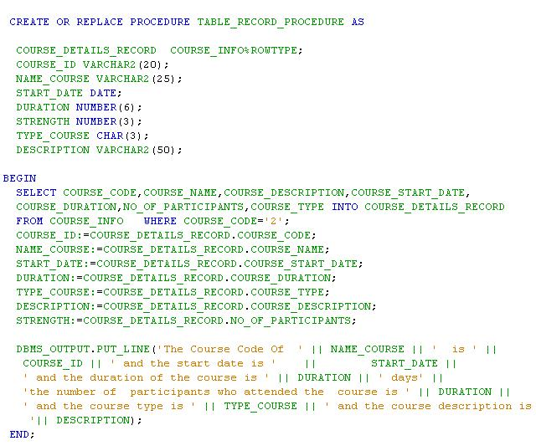
Lend A Hand-Table Based Records Solution
NOTE: The fields in the select clause should have all the columns of the table for which the row type is defined.

Slide 21
Custom Defined Record
Declaring a Programmer Defined Record:
The TYPE...RECORD keyword is used to define a custom record in which each field is declared with a name and datatype.
Syntax :
TYPE <record_type_name> IS RECORD
(<field name 1><datatype1>,
<field name 2><datatype2>,
.....
<field name N><datatypeN>);
<record Name> record_type_name ;
Example:
TYPE Emp_Record_Type IS RECORD(
EMP_ID NUMBER(6),
EMP_NAME VARCHAR2(25)) ;
EMP_RECORD Emp_Record_Type;
Alias/Identifier name for the record
The above Record contains two fields namely EMP_ID,EMP_NAME

Slide 22
Table Vs Custom Records
Table based records used when, in a program all the columns of a table needs to be referenced, stored and processed. Failing to do this will result in an error.
Custom records are used when only few columns of one or more table(s) needs to be referenced , stored and processed (or) when programmer needs to define a customized structure for accessing/storing data.

Slide 23
Custom Record -Example
DECLARE
TYPE Emp_Record_Type IS RECORD(
EMP_ID NUMBER(6),
EMP_NAME VARCHAR2(25)) ;
EMP_RECORD Emp_Record_Type;
BEGIN
SELECT EMPLOYEENUMBER,FIRSTNAME INTO EMP_RECORD
FROM EMPLOYEES WHERE JOBTITLE=‘PRESIDENT’
DBMS_OUTPUT.PUT_LINE('THE DETAILS OF PRESIDENT ARE');
DBMS_OUTPUT.PUT_LINE(EMP_RECORD.EMP_ID);
DBMS_OUTPUT.PUT_LINE(EMP_RECORD.EMP_NAME);
END;
Declaring the record
Assigning values to the record

Slide 24
Lend A Hand
Now we are well versed with commands lets test our understanding using short case study
Case Study Scenario:
This case study is to develop a Course Management System (CMS) for ABC University. The following are the two use cases for which the database needs to be designed.
Add Course
– To add the course details into the course management system.
Retrieve Course
– Retrieve the courses stored in the system and display it.
The courses to be added will have the following attributes Course Code, Course Name, Number of participants, Course Description, Course Duration, Course start date and Course Type.
Course Management System (CMS) ABC University

Slide 25
Lend A Hand-Custom Record
Pre Requisites: Use the CMS Course_Info Tables.
Objective: To lean the usage of custom records.
Problem Statement # 1: Develop a procedure which retrieves few details of the course whose course code course_code=‘4’.
Since we are not displaying all the columns in the course_onfo table we need to go for customized records definition
Expected Output:
“The Course Code Of ” +<Course_Name> +” is “ +<Course_Code> “ and the start date is “ +<Course_Start_Date> + “ and the duration of the course is “+<Course_Duration> +” days ”

Slide 26
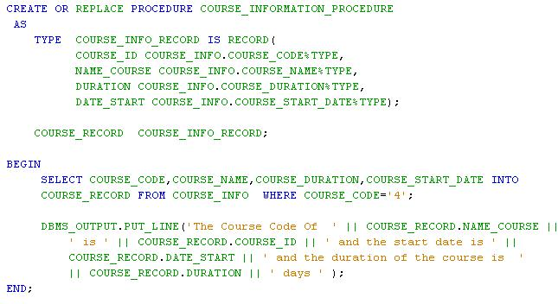
Lend A Hand-Custom Record Solution
Solution:

Slide 27
Cursor Based Record
Declaring a cursor based record:
Use the %ROWTYPE attribute with an explicit cursor or cursor variable .
Syntax:
Declare
CURSOR <CURSOR-NAME> IS
<SELECT STATEMENT;>
<RECORD-NAME>< CURSOR- NAME >%ROWTYPE;
Example:
DECLARE
CURSOR EMP_DETAILS IS
SELECT EMPLOYEENUMBER,LASTNAME FROM EMPLOYEES;
MY_RECORD EMP_DETAILS %ROWTYPE;
The above example creates a record of two fields EMPLOYEENUMBER and LASTNAME

Slide 28
Cursor Based Record-Example
DECLARE
CURSOR EMP_CURSOR IS
SELECT EMPLOYEENUMBER,LASTNAME FROM EMPLOYEES;
MY_EMP EMP_CURSOR%ROWTYPE;
BEGIN
OPEN EMP_CURSOR ;
LOOP
FETCH EMP_CURSOR INTO MY_EMP ;
EXIT WHEN EMP_CURSOR%NOTFOUND;
DBMS_OUTPUT.PUT_LINE(
MY_EMP.EMPLOYEENUMBER || ‘ ‘ ||MY_COURSE.LASTNAME);
END LOOP;
CLOSE EMP_CURSOR ;
END;
Cursor based record is declared
Cursor is executed and stored in record

Slide 29
Lend A Hand
Now we are well versed with commands lets test our understanding using short case study
Case Study Scenario:
This case study is to develop a Course Management System (CMS) for ABC University. The following are the two use cases for which the database needs to be designed.
Add Course
– To add the course details into the course management system.
Retrieve Course
– Retrieve the courses stored in the system and display it.
The courses to be added will have the following attributes Course Code, Course Name, Number of participants, Course Description, Course Duration, Course start date and Course Type.
Course Management System (CMS) ABC University

Slide 30
Lend A Hand-Cursor Based Records
Pre Requisites: Use the CMS Course_INFO Tables.
Problem Statement : Develop a PL SQL block which iterates through the courses retrieves the course details from the Course_INFO table and display the message.
Expected Output:
“The Course Code Of ” +<Course_Name> +” is “ +<Course_Code> “ and the start date is “ +<Course_Start_Date> + “ and the duration of the course is “+<Course_Duration> +” days ” .

Slide 31
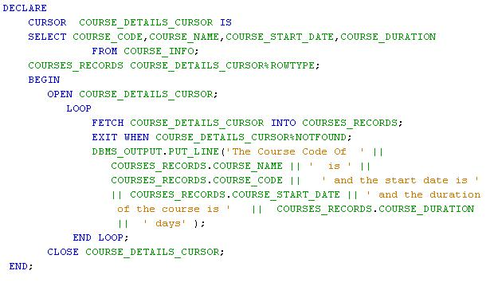
Lend A Hand-Solution

Slide 32
Check Your Understanding
Can a record have multiple fields?
Can a record have fields of multiple data types?
What is the record type used for representing a record of a table?
What is the difference between Table based records and Programmer defined records?

Slide 33

Collection
What is a collection?
A “collection” is simply a container that groups multiple elements into a single unit.
In PL SQL
A collection is an ordered group of data, all of the same type.
Elements
1…n
Collection
Collections are used to:
Store
Retrieve
Manipulate
IMPORTANT: It is enough for the associates to have knowledge on each collection types.

Slide 34
PL SQL Collections
Types of Collections
Associate Arrays or Index By Tables
VARRAYS
Nested Tables
More about PL SQL Collection:
Each element has a unique index that determines its position in the collection.
Individual elements in a collection can be accessed by using index.

Slide 35
Index-By Tables
What are Index-By Tables/Associative Arrays?
Index-By Tables also called as associative array is a set of key-value pairs.
Each key is unique, and is used to locate the corresponding value.
The Value can be either a scalar data type or record.
They are similar to hash tables in other programming languages.
The size of the Index-By Tables will dynamically increased based on the values stored in Index By Tables.
Index-By Tables elements:
Key: To store the key, data type BINARY_INTEGER.
Value: Represents the value for a key, can be a scalar or record data type.

Slide 36
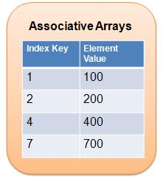
Index-By Tables Structure
Associative arrays are used for storing key and value pairs. Key will be integer and value can be any scalar types or records.

Slide 37
Index-By Tables- Example
Syntax:
Declare
TYPE type_name IS TABLE OF
element type [NOT NULL]
INDEX BY [BINARY_INTEGER];
Identifier type_name;
Example:
TYPE EMP_TABLES_TYPE IS TABLE OF
EMPLOYEES.LAST_NAME%TYPE
INDEX BY BINARY_INTEGER;
My_Table EMP_TABLES_TYPE ;
Define the index by table.
Last name is the value
Binary integer is the key.
The above example creates a collection EMP_TABLES_TYPE with one column last_name in employees table. The BINARY_INTEGER is the key to locate a name.
Index Key | Value
1 | Jack
2 | Ron
3 | Tim
An element of Index by table with key 2 and employee name Ron.

Slide 38
Index By Tables In bulit Functions
The following are the some of the inbuilt functions of Index By Tables.
Function Name | Description
FIRST | Returns the first element in the index by tables. If index by tables is empty return NULL.
LAST | Returns the last element in the index by tables. If index by tables is empty return NULL.
COUNT | Returns the total number of elements that index by tables currently contains.
NEXT(n) | Returns the next index value that follows the given index. If no index is available then it returns NULL. This method ignores null values.
DELETE(n) | Removes the value in the specific from the Index By Table.
The above methods can also be used with VARRAY’s and Nested Tables also

Slide 39
Index By Table Example
Define the type
DECLARE
TYPE NAME_ARRAY IS TABLE OF VARCHAR2(25)
INDEX BY BINARY_INTEGER;
EMP_NAMES NAME_ARRAY;
NAME_KEYS NUMBER;
BEGIN
EMP_NAMES(1051):=‘Arun’;
EMP_NAMES(1052):=‘Vimal’;
EMP_NAMES(1053):=‘Karan’;
NAME_KEYS:=EMP_NAMES.FIRST;
FOR NUM IN 1051.. EMP_NAMES.COUNT LOOP
INSERT INTO EMPLOYEES(EMPLOYEENUMBER,LAST_NAME)
VALUES (NAME_KEYS,EMP_NAMES(NAME_KEYS));
DBMS_OUTPUT.PUT_LINE(
EMP_NAMES(NAME_KEYS) || ‘ inserted’ );
NAME_KEYS:= EMP_NAMES.NEXT(NAME_KEYS);
END LOOP;
END;
Declare the type
Load the Data
Set the Index to Top
Iterate through the collection and load the table

Slide 40
VARRAYS
What are VARRAYS?
VARRAY stands for variable-size array.
VARRAYs are single-dimensional collections of same data type.
When VARRAY’s are defined the maximum number of elements it can hold must be specified.
A VARRAY can contain a varying number of elements, from zero (when empty) to the maximum size specified in its type definition
Syntax:
TYPE type_name IS {VARRAY | VARYING ARRAY} (size_limit)
OF element_type [NOT NULL];

Slide 41
Creating and Using VARRAYS
Creating A VARRAY:
CREATE OR REPLACE TYPE COUNTRIES AS VARRAY(10) OF VARCHAR2(128);
Using the VARRRAY WHILE CREATING A TABLE:
CREATE TABLE TEST_TABLE(ID NUMBER , COUNTRY_LIST COUNTRIES);
Inserting Data into VARRAY Column Type:
Insert into TEST_TABLE values(1,COUNTRIES(‘India’));
Insert into TEST_TABLE values(2, COUNTRIES(‘Syria’,’China’));
Insert into TEST_TABLE values(3, COUNTRIES (‘Japan’,’Kenya’,’Libya’));
Retrieving Data:
SELECT t1.id, t2.column_value FROM TEST_TABLE t1, TABLE(t1.COUNTRY_LIST) t2;

Slide 42

Summary
We have learnt following
PL SQL Composite Data Types
PL/SQL records
PL/SQL collections

Slide 43
Source
http://en.wikipedia.org/wiki/SQL
Disclaimer: Parts of the content of this course is based on the materials available from the Web sites and books listed above. The materials that can be accessed from linked sites are not maintained by Cognizant Academy and we are not responsible for the contents thereof. All trademarks, service marks, and trade names in this course are the marks of the respective owner(s).

Slide 44
ORACLE PL/SQL
You have successfully completed -
PL/SQL Composite Data Types

Slide 45
Change Log
Version Number | Changes made
V1.0 | Initial Version
V1.1 | Slide No. | Changed By | Effective Date | Changes Effected

